Slide 1
Transit Oriented Development Overlay District
Public Information Meeting
November 5, 2020
6:00 PM
Incorporated Village of Island Park, NY

Slide 2
Agenda
Opening Remarks
Project Overview
Public Comments
Next Steps

Slide 3
Opening Remarks

Slide 4
Assets
Waterfront location
Gateway to the City of Long Beach
Long Island Railroad station within walking distance of downtown
Long Beach Road – commercial corridor

Slide 5
Challenges
Stagnant economic performance, vacant storefronts, lack of diversified housing options, deficient pedestrian activity, and underutilization of the waterfront.
Superstorm Sandy caused substantial damage to businesses along Long Beach Road; many were closed, some have not reopened.
Existing Commercial Districts do not allow residential uses. Existing Business District does not permit non-age-restricted residential uses.
Limits the Village from offering diversified housing options and meeting the growing demand for mixed-use, multi-family housing near transit.
Current zoning does not provide the tools necessary to encourage a vibrant, walkable downtown.

Slide 6
Opportunities
Build upon prior planning studies that recommend transit-oriented and walkable neighborhood development centered around the downtown, the LIRR station and Austin Blvd
Facilitate revitalization through the implementation of a new TOD Overlay District
Encourage development/redevelopment within Business and Commercial Districts proximate to the LIRR station
Provide the framework for future development and revitalization of the Village

Slide 7
Purpose
Maintain underlying zoning in order not to create non-conforming uses
Grow and solidify the tax base
Reduce traffic congestion and parking demand
Improve resiliency and sustainability
Provide housing options within walking distance to downtown and transit
Maintain overall character of the Village
Ensure that Village resources are not over-burdened by future development

Slide 8
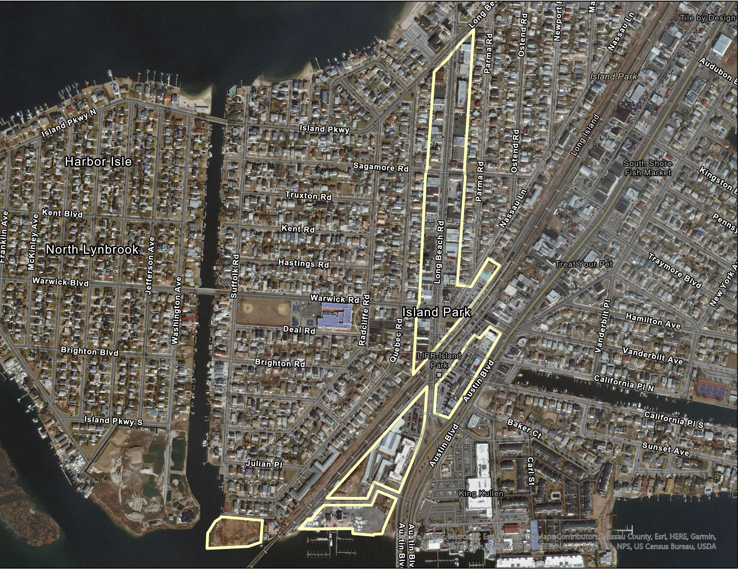
INSER TOD MAP HERE
Train Station
Proposed TOD Overlay

Slide 9
How We Got Here NY Rising Reconstruction Plan (2014)
Public engagement created a shared vision for the community.
“Rebuild in a manner that increases resilience, sustainability, and offers greater prosperity to ensure the area’s long-term success.”
“Protect residents and businesses from future storms, zoning and building codes for the Town of Hempstead and the Village of Island Park could be amended to support more resilient reconstruction methods for residential, commercial, and public structures.”
“Zoning changes to encourage mixed-use development throughout the downtown and waterfront area.”
Vision: “Enhance the quality of life and chart a course towards the future by creating solutions to rebuild and revitalize two communities that are enriched by the diversity of their residents. Facilitate positive, innovative change that will provide an environment that is SAFE and an infrastructure that is RESILIENT, so that each community can thrive, sustain itself in the face of adversity and preserve its uniqueness and charm.”

Slide 10
How We Got Here Perkins Eastman/ DASNY Study - Downtown Revitalization and Transit Oriented Development Plan (2017)
Current zoning prohibits the kind of uses that would make Long Beach Road more vibrant.
Quality design needed to ensure new development works with, and complements the Village’s goal of creating a pedestrian, bicycle, and vehicle friendly environment for Island Park.
New residential and non-residential uses should be allowed as-of-right, located in the same building or side-by-side.

Slide 11
What is a zoning overlay?
Overlay Zoning
A tool that creates a special zoning district, placed over an existing base zone(s), which identifies special provisions in addition to those in the underlying base zone

Slide 12
TOD Subdistricts
Business Subdistrict
Applicable to properties located within the existing Business District and Commercial B District
Waterfront Subdistrict
Applicable to properties located along the Village’s waterfront and zoned either Commercial A or Commercial C

Slide 13
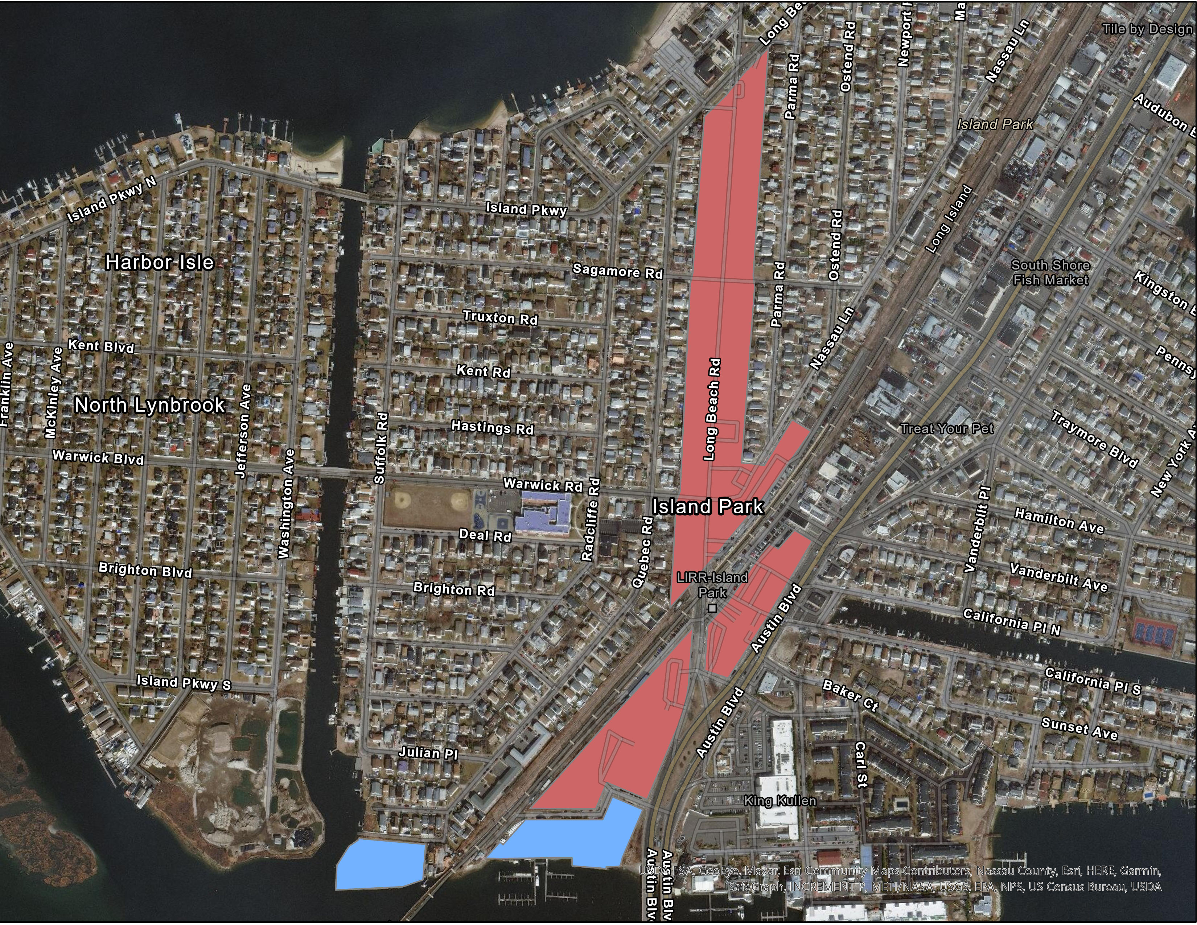
Train Station
Waterfront Subdistrict
Business Subdistrict

Slide 14
Permitted Uses
Business Subdistrict
Existing permitted uses in underlying zoning districts
Apartment houses or multiple dwellings
Mixed-use buildings
Off street parking and loading
Open space or plaza areas
Signage
Waterfront Subdistrict
Existing permitted uses in underlying zoning districts
Apartment houses or multiple dwellings
Off street parking
Signage
Boat slips associated with multiple dwelling units
Indoor/outdoor recreational facilities associated with multiple dwelling units

Slide 15
Bulk and Dimensional Regulations
 | TOD Overlay - Business Subdistrict | TOD Overlay - Waterfront Subdistrict
Minimum Lot Size | None | 2 acres
Maximum Building Coverage | 80% | 30%
Maximum Building Height Without Surface Parking Below With Surface Parking Below | 3 stories and 40 feet 4 stories and 50 feet | 3 stories and 40 feet 4 stories and 50 feet
Minimum Front Yard | 10 feet | 25 feet
Minimum Side Yard(s) | 0 feet | 20 feet each side yard
Minimum Rear Yard | 10 feet | 25 feet

Slide 16
Parking Regulations
Use | TOD Business District | TOD Waterfront District
Retail/Commercial | 1 space per 300 SF | See §625-35
Multiple Dwelling/Apartment House: Studios | 1 space per unit | 1 space per unit
Multiple Dwelling/Apartment House: One-bedroom units | 1 space per unit | 1.3 spaces per unit
Multiple Dwelling/Apartment House: Two-bedroom units | 1.5 spaces per unit | 1.75 spaces per unit
Multiple Dwelling/Apartment House: Three-or-more bedroom units | 1.75 spaces per unit | 2 spaces per unit
All Other Permitted Uses | Shall comply with the parking requirements outlined in §§625-35 and/or 625-38 of the Village Zoning Code
Note: A minimum of one parking space per unit must be accommodated on site

Slide 17
Two Step Application Process
Step 1: Preliminary Application
An applicant may petition the Village Board of Trustees and file with the Superintendent of Buildings.
Within 60 days, the Board of Trustees shall decide to either advance the preliminary application for further consideration or deny the preliminary application and end the consideration of such application.
Step 2: Final Application
If the Board of Trustees decides to entertain an application, the applicant will need to submit a detailed set of plans and other materials.
Once all materials have been submitted, a public hearing will be scheduled within 60 days.
The Board of Trustees will deny, approve or approve with modifications/ conditions within 60 days of the close of the public hearing.

Slide 18
Sustainability Component
Sustainability and green building refer to the practice of creating buildings using a process that is environmentally responsible and resource-efficient throughout a building’s life-cycle.
All development would be compliant with State and Federal regulations including, but not limited to, the Federal Emergency Management Agency and New York State Energy Conservation Construction Code.

Slide 19
Next Steps
Finalize Build-Out Analysis
Conduct Environmental Review – SEQRA Process
Public Hearing
Adopt SEQRA Determination of Significance, Adopt Zoning

Slide 20
Public Comments

